Slide 1

Transformers Workshop
Internals and Insights
Caus Danu

Slide 2
Background
This resource is intended to explain Transformers to a scientific audience.
Transformers will be presented in the broader context of AI, so touching different other relevant topics.
I will act therefore as a synthesizer of many resources created by the broader AI community.
Hence, Many Thanks! to all the creators of the helper material. All credits and references are visible on the last slides.
Same references are also given in the footnotes section of each individual slide, which is not visible in presentation mode, but will be useful for referencing at home for extra study if need be.
Slide content
(visible in presentation mode)
Footnote URL / reference
(not visible during presentation)

Slide 3
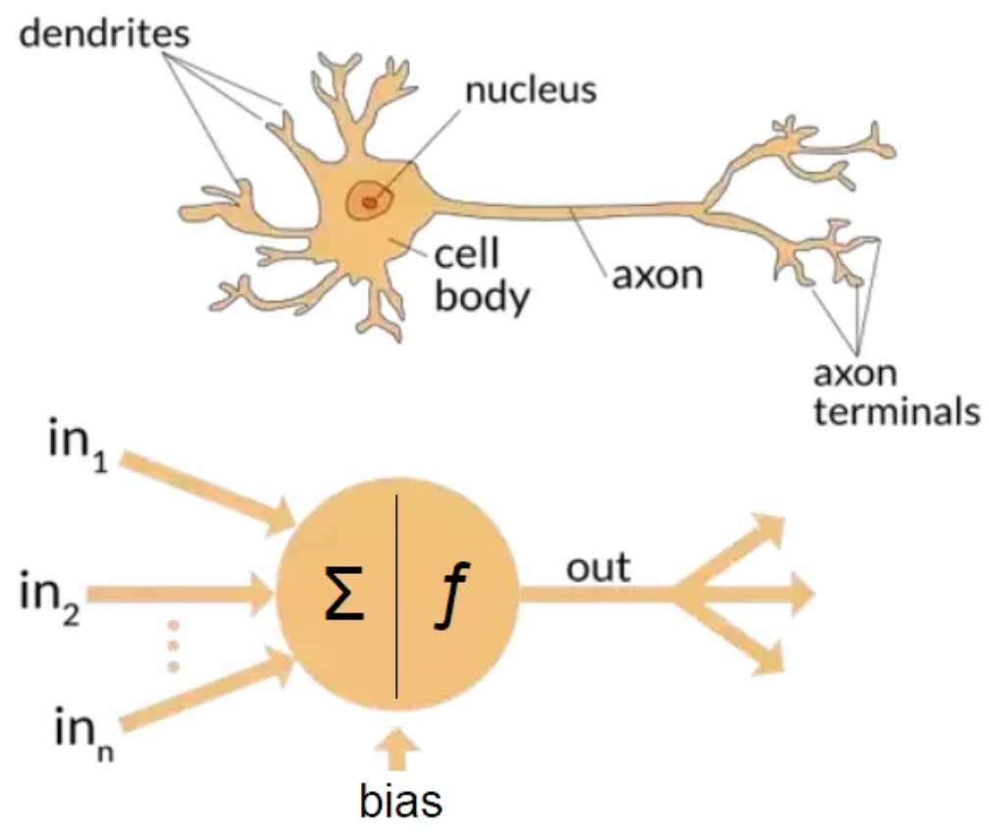
Artificial Neural Nets and Brain Parallels
Notes:
https://towardsdatascience.com/the-differences-between-artificial-and-biological-neural-networks-a8b46db828b7

Slide 4
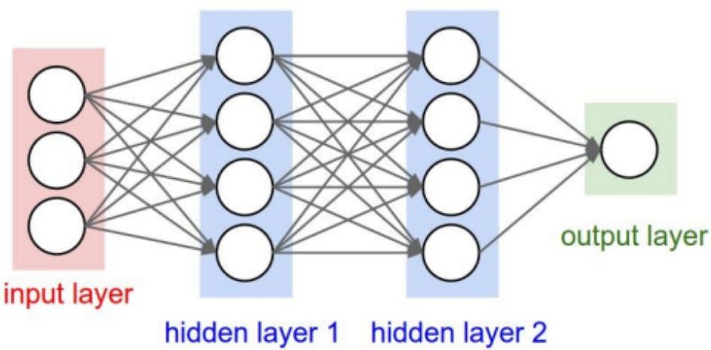
Artificial Neural Networks (ANNs)
CS231n course from Stanford University
Notes:
http://cs231n.stanford.edu/slides/2019/cs231n_2019_lecture04.pdf

Slide 5
Backpropagation
Feed-forward / Inference
Training using Backpropagation
CS231n course from Stanford University
Notes:
http://cs231n.stanford.edu/slides/2019/cs231n_2019_lecture04.pdf

Slide 6
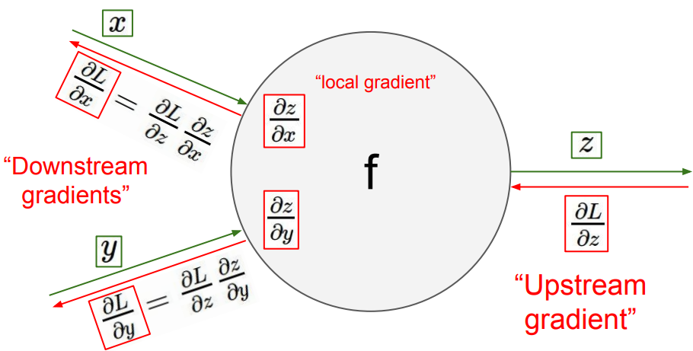
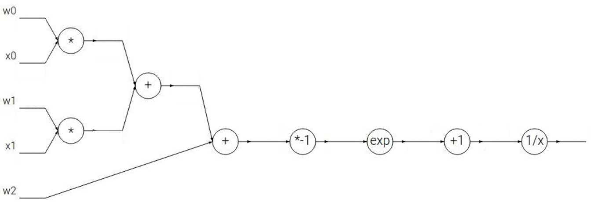
Backpropagation using Local Gradients and Chain Rule
The Chain Rule is implemented with the help of local gradients.
We recursively multiply the local derivatives.
Backpropagation is a recursive application of the chain rule backwards through the computation graph.
CS231n course from Stanford University
Notes:
http://cs231n.stanford.edu/slides/2019/cs231n_2019_lecture04.pdf

Slide 7
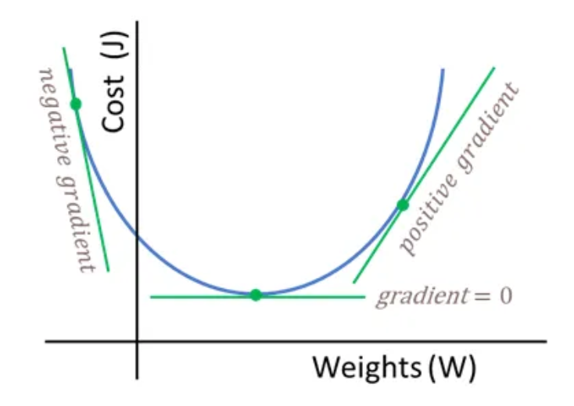
Cost function
Notes:
https://towardsdatascience.com/neural-networks-backpropagation-by-dr-lihi-gur-arie-27be67d8fdce

Slide 8
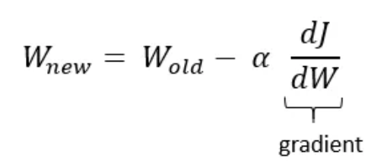
Weights update
J and L are usual notations for the Loss / Error / Cost function, i.e. the difference between what the model predicts and what it should predict according to the ground truth.
The weights are updated in the direction of the negative gradient, so that the cost function is minimized as much as possible.
Notes:
https://towardsdatascience.com/neural-networks-backpropagation-by-dr-lihi-gur-arie-27be67d8fdce

Slide 9
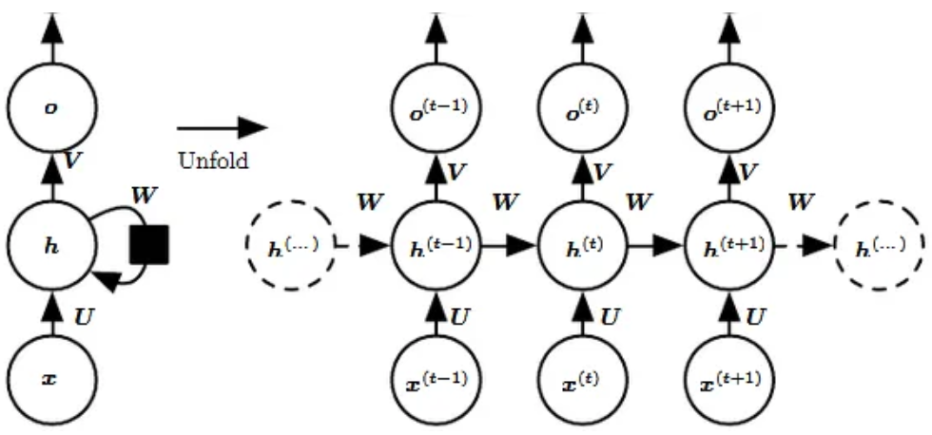
Sequential nature of Recurrent Neural Networks (RNNs)
By unfolding the feedback loop in time, we become aware of the complexity of these networks. It is as if we train a very deep network and that is why they are harder to train.
With RNNs things are done sequentially => deep graph structure.
With Transformers things happen parallely => broad graph structure.
Transformers might simply be easier to train stably, and maybe that is why they have better results.
Notes:
https://towardsdatascience.com/recurrent-neural-networks-rnns-3f06d7653a85

Slide 10
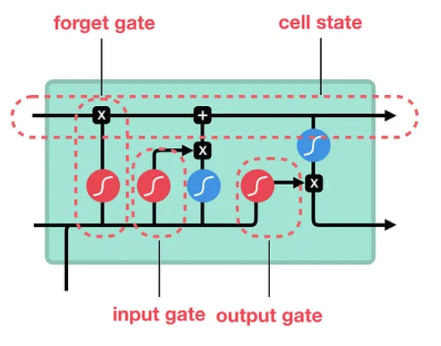
Long short-term memory (LSTMs)
Contains special gates that address the problem of vanishing gradients.
Addresses the problem of exploding gradients.
Notes:
https://medium.com/towards-data-science/illustrated-guide-to-lstms-and-gru-s-a-step-by-step-explanation-44e9eb85bf21

Slide 11
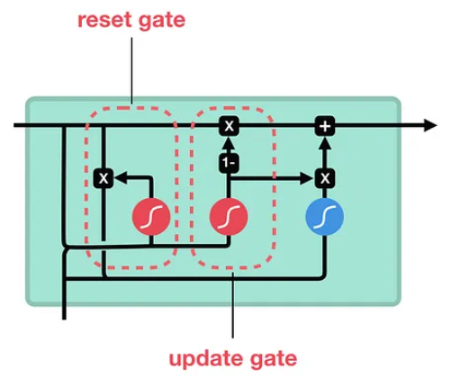
Gated Recurrent Units (GRUs)
Generally considered faster than LSTMs.
In practice => similar outcomes to what LSTM provides.
Notes:
https://medium.com/towards-data-science/illustrated-guide-to-lstms-and-gru-s-a-step-by-step-explanation-44e9eb85bf21

Slide 12
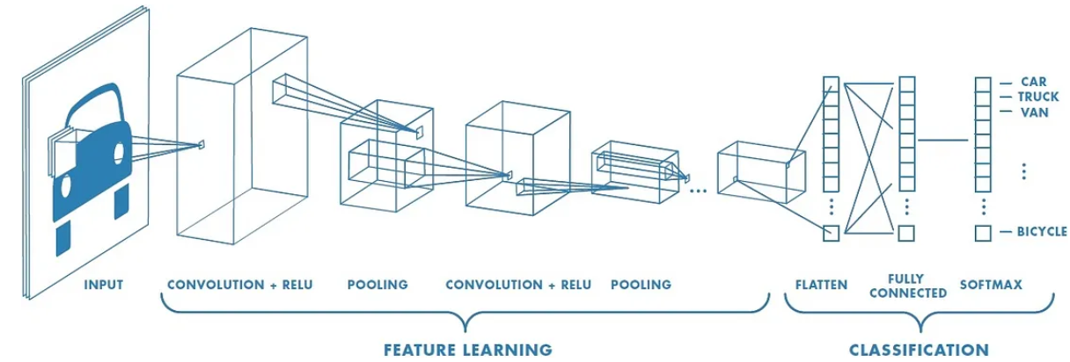
Convolutional Neural Networks (CNNs)
Generally applied in computer vision tasks, i.e. 2D image focused, not time sequence data.
We can use 3D CNNs to handle sequences of data, where 3rd dimension is time. Here we talk about a cube kernel, instead of a plane 2D kernel.
CNNs are very amenable to parallelism.
Notes:
https://medium.com/@RaghavPrabhu/understanding-of-convolutional-neural-network-cnn-deep-learning-99760835f148

Slide 13
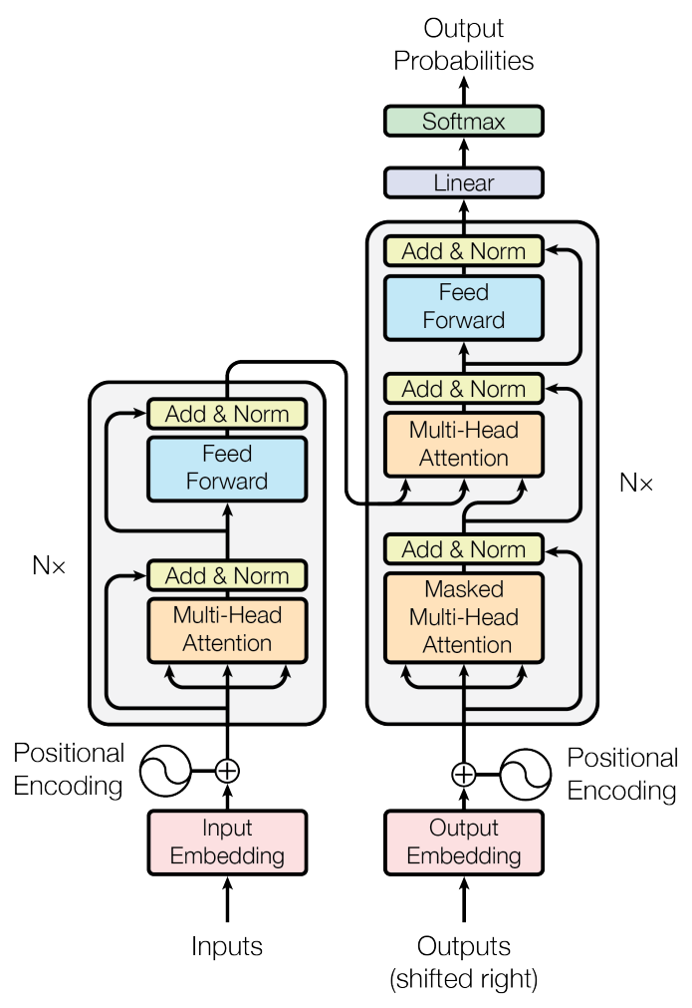
Transformers
“Attention is all you need” paper from 2017 by Vaswani et al.
Notes:
Figure 1 taken from paper “Attention is all you need” by Vaswani et al. -> https://arxiv.org/pdf/1706.03762.pdf

Slide 14
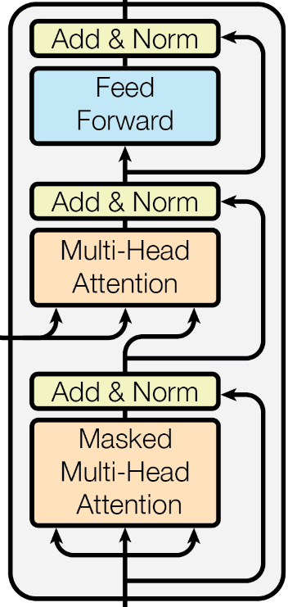
Transformer Block
2. Secondly, a Multilayer Perceptron (MLP) crunches the data that was communicated amongst tokens in the previous self-attention phase.
First the tokens communicate between themselves / they attend to each other (self-attention).

Slide 15
Self-Attention
. . .
Token 1
Token 2
Token 3
Token N
All tokens communicate with one another.
This is computationally expensive because each token has to look at every other token to compute an attention score / attention weight.

Slide 16
Key, Query and Value Embeddings
Key -> “What do I contain”.
Token
Value ->
“If you find me interesting, this is what I will communicate to you”.
Query ->
“What am I looking for”.

Slide 17
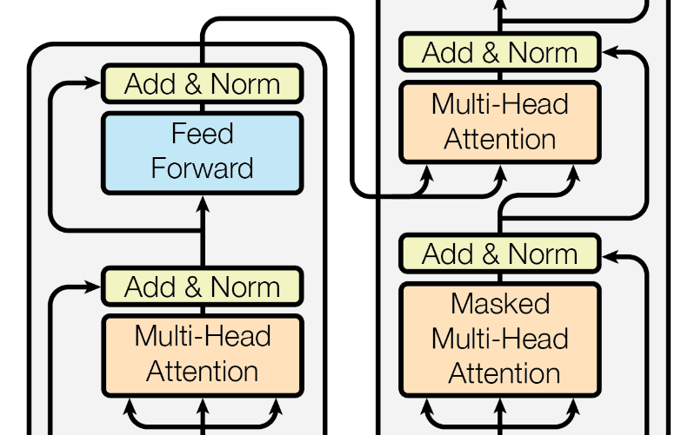
Self-Attention vs Cross-Attention
Cross-Attention -> the queries come from the decoder, whereas the keys and values are from the encoder side.
Self-attention -> the key, query and value vectors are related to the same entity, either the encoder, or the decoder.

Slide 18
Mathematically Expressing Self-Attention
The dot product Query ・ Key is the attention score.
Dot product measures similarity between vectors => Attention can be interpreted as the alignment between the Key and the Query vectors (i.e. two tokens find each other interesting).
Instead of the dot product, other measures can be used, like the cosine similarity for example (Swin Transformer Version 2 paper).

Slide 19
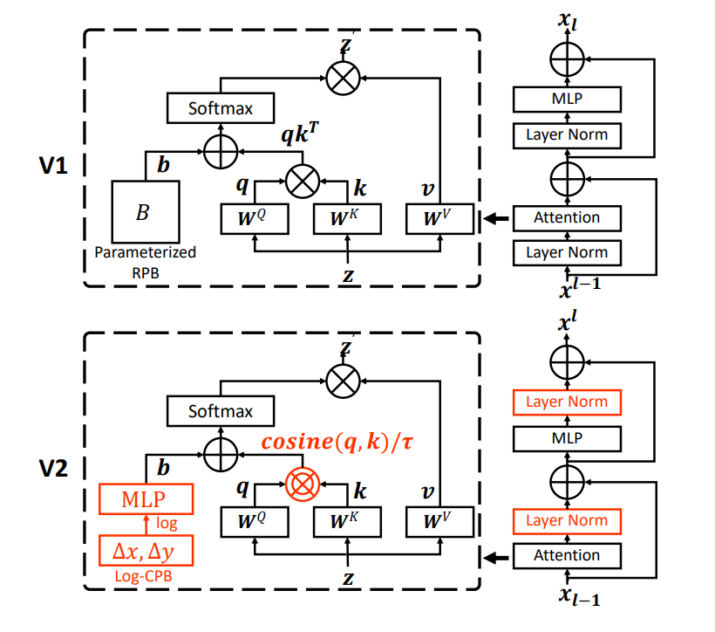
Cosine similarity
Notice the pre-Layer Norm
vs
post-Layer Norm
switch.
“Swin Transformer V2: Scaling Up Capacity and Resolution” by Liu et al.
Notes:
Figure 1 from “Swin Transformer V2: Scaling Up Capacity and Resolution” paper by Liu et al. -> https://arxiv.org/abs/2111.09883

Slide 20
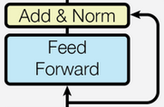
Computation Phase / Feed-Forward MLP
After the communication between tokens is finished, an MLP has to “think” on what was “said” during the self-attention phase.
This basically means that new features are computed / derived as a result of the communication.
Let’s fast forward back to what we’ve already seen

Slide 21
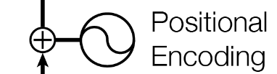
Positional encoding
The transformer treats the tokens as a Bag of Words (BOG).
We need to give each token a label that specifies its position in the form of a counter ID for instance.
It is interesting that the positional encoding information is simply added literally by a “+”/ plus operation.
There are various encoding schemes such as for example absolute encoding, relative encoding, that have a significant impact on how the transformer ends up performing. Check out the Swin Transformer paper for empirical proof.

Slide 22
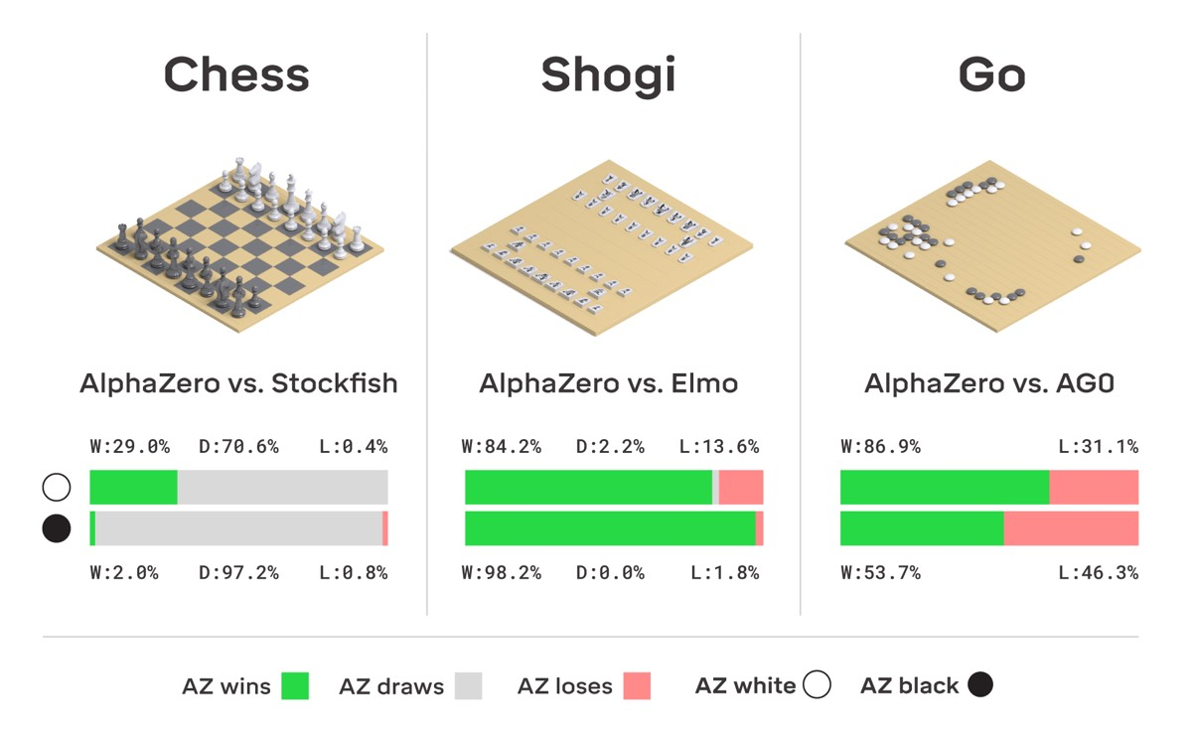
ChatGPT Pipeline
Pretraining the base model.
Supervised Fine-Tuning (SFT).
Reward Modeling / RM.
Reinforcement Learning / RL (Very much research territory at the moment).
Personal opinion: ChatGPT works so well, because it borrowed many insights from the AlphaZero games playing engine from back in 2016.
DeepMind subsequently created AlphaStar and AlphaFold using similar principles.
Notes:
https://arstechnica.com/science/2018/12/move-over-alphago-alphazero-taught-itself-to-play-three-different-games/

Slide 23
Pretraining the Foundational Model
Use raw data to train a Base Model.
The dataset is huge => potentially low quality, but very large quantity.
We obtain a document completer in the end.
Thousands of GPUs work in parallel (ex: 1000-2000 A100 GPUs)

Slide 24
Supervised Fine Tuning (SFT stage)
Low quantity, high quality data: ~ 100K (prompt, response) tuples.
Domain Specialists / Contractors have to scrutinize the dataset so that close to ideal (prompt, response) tuples are assembled.
Less GPUs are required (ex: 1-100).
The outcome is the so-called SFT model.

Slide 25
Reward Modeling
Ask the SFT model to produce multiple answers per prompt.
Ask contractors to carefully rank these answers.
Train a reward model on these rankings.
Order of 1 to 100 GPUs for training.
The outcome is the so-called Reward Model / RM => Evaluates token trajectories.
Token 01 | Token 02 | Reward 1
Token trajectory 1
Token 11 | Token 12 | Token 13
Token 14 | Token 15 | Reward 2
Token trajectory 2
Token 21 | Token 22 | Token 23
Token 24 | Token 25 | Token 26
Token 27 | Token 28 | Reward 3
Token trajectory 3

Slide 26
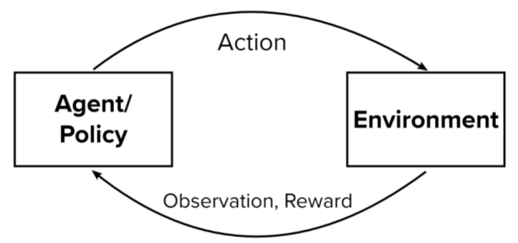
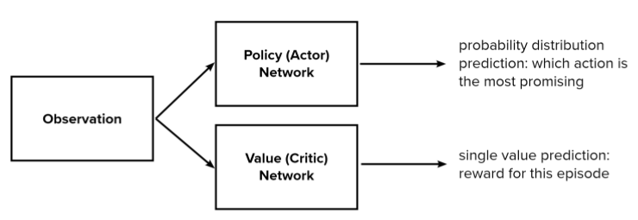
Reinforcement Learning
Train a PPO algorithm (Proximal Policy Optimization).
Use the previously trained reward model to evaluate the reward.
PPO will have the job of generating token “trajectories” that will have a very good overall score.
Order of 1 to 100 GPUs for training.
The outcome is the so called RL model / RLHF (reinforcement learning with human feedback).
Notes:
https://odsc.com/blog/reinforcement-learning-with-ppo/

Slide 27
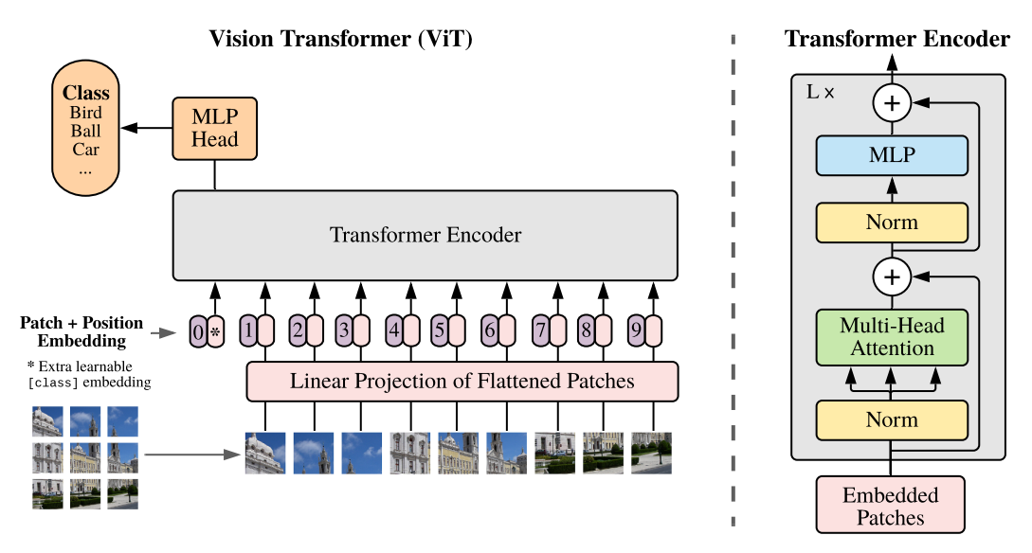
Vision Transformer / ViT
“An Image is Worth 16x16 Words: Transformers for Image Recognition at Scale” by A. Dosovitskiy et al. (2021)
Notes:
Figure 1 from the paper “An image is worth 16x16 words: Transformers for image recognition at scale” by A. Dosovitskiy et al. -> https://arxiv.org/pdf/2010.11929v2.pdf

Slide 28
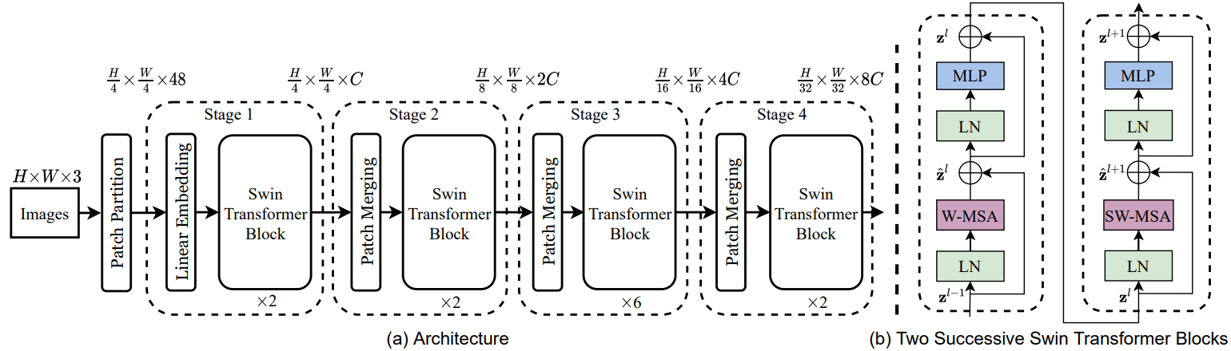
Swin Transformer
“Swin Transformer: Hierarchical Vision Transformer using Shifted Windows” by Liu et al. (2021)
Notes:
Figure 3 from the paper “Swin Transformer: Hierarchical Vision Transformer using Shifted Windows” by Liu et al. -> https://arxiv.org/pdf/2103.14030.pdf

Slide 29
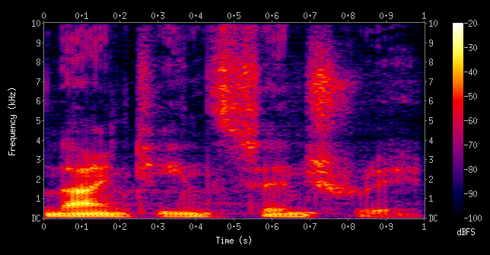
Audio Transformer
Raw sound waves can be mapped to a different space using STFT (Short-time Fourier Transform).
Here time series become images => problem is adapted to be addressed by the ViT / Swin Transformer.
Notes:
https://en.wikipedia.org/wiki/Short-time_Fourier_transform#/media/File:Spectrogram-19thC.png

Slide 30
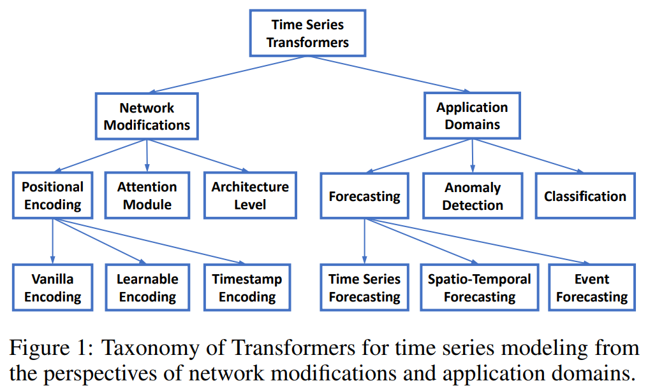
Time Series Transformer (TST)
Continuous data is sampled and quantized into discrete tokens.
Implementations available at: https://huggingface.co/docs/transformers/model_doc/time_series_transformer
“Transformers in Time Series: A Survey” paper, by Wen et al. [2023]
Notes:
Figure 1 from the “Transformers in Time Series: A Survey” paper, by Wen et al. -> https://arxiv.org/pdf/2202.07125.pdf ; https://github.com/qingsongedu/time-series-transformers-review

Slide 31
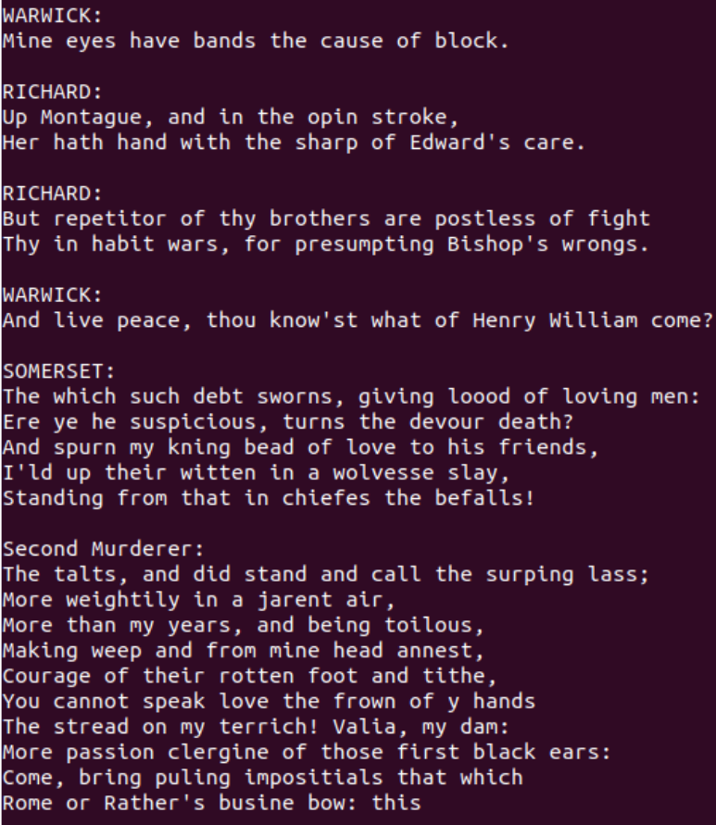
Mini-GPT Qualitative Results
Trained on DKRZ server:
Also, checkout -> https://www.nytimes.com/interactive/2023/04/26/upshot/gpt-from-scratch.html
Notes:
On DKRZ server.

Slide 32
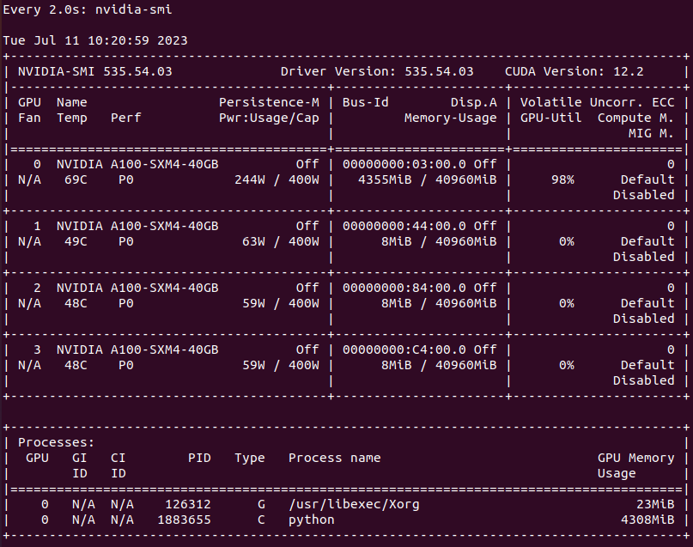
Training on GPU
Notes:
On DKRZ server.

Slide 33
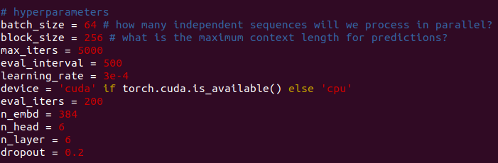
Transformer Hyperparameters
Notes:
Code reproduced using https://github.com/karpathy/ng-video-lecture on DKRZ server

Slide 34
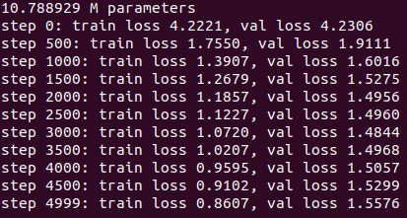
Train Info Logs
Starts to overfit
Notes:
On DKRZ server.

Slide 35
Takeaways
Transformers are powerful neural networks that borrow the best ideas from prior models in the AI ecosystem and combine them together for a synergistic effect.
Self-attention and Feed-Forward MLP are the major conceptual components of a Transformer block.
Self-attention is essentially a communication graph where tokens exchange information stored in channels amongst themselves.
The Feed-Forward MLP is used for the computation phase to learn embeddings.
Residual connections and pre- / post-normalization are other important attributes to help towards successful training and faster convergence.

Slide 36
References
Slide 3: https://towardsdatascience.com/the-differences-between-artificial-and-biological-neural-networks-a8b46db828b7
Slide 4, 5, 6: http://cs231n.stanford.edu/slides/2019/cs231n_2019_lecture04.pdf
Slide 7, 8: https://towardsdatascience.com/neural-networks-backpropagation-by-dr-lihi-gur-arie-27be67d8fdce
Slide 9: https://towardsdatascience.com/recurrent-neural-networks-rnns-3f06d7653a85
Slide 10, 11: https://medium.com/towards-data-science/illustrated-guide-to-lstms-and-gru-s-a-step-by-step-explanation-44e9eb85bf21
Slide 12: https://medium.com/@RaghavPrabhu/understanding-of-convolutional-neural-network-cnn-deep-learning-99760835f148
Slides 13, 14, 17, 20, 21 Transformer components were taken from “Attention is all you need” paper, by Vaswani et al.
Slide 19: “Swin Transformer V2: Scaling Up Capacity and Resolution” paper, by Liu et al.
Slide 22: https://arstechnica.com/science/2018/12/move-over-alphago-alphazero-taught-itself-to-play-three-different-games/
Slide 26: https://odsc.com/blog/reinforcement-learning-with-ppo/
Slide 27: “An image is worth 16x16 words: Transformers for image recognition at scale” paper, by Dosovitskiy et al.
Slide 28: “Swin Transformer: Hierarchical Vision Transformer using Shifted Windows” paper, by Liu et al.
Slide 29: https://en.wikipedia.org/wiki/Short-time_Fourier_transform#/media/File:Spectrogram-19thC.png
Slide 30: “Transformers in Time Series: A Survey” paper, by Wen et al.

Slide 37
Appendix: Self-Attention Snippet Version 1
torch.Size([4, 8, 2])
tensor([[ 1.9269, 1.4873],
[ 0.9007, -2.1055],
[ 0.6784, -1.2345],
[-0.0431, -1.6047],
[-0.7521, 1.6487],
[-0.3925, -1.4036],
[-0.7279, -0.5594],
[-0.7688, 0.7624]])
tensor([[ 1.9269, 1.4873],
[ 1.4138, -0.3091],
[ 1.1687, -0.6176],
[ 0.8657, -0.8644],
[ 0.5422, -0.3617],
[ 0.3864, -0.5354],
[ 0.2272, -0.5388],
[ 0.1027, -0.3762]])
# Version 1:
# We want x[b,t] = mean_{i<=t} x[b,i]
xbow = torch.zeros((B,T,C))
for b in range(B):
for t in range(T):
xprev = x[b,:t+1] # (t,C)
xbow[b,t] = torch.mean(xprev, 0)
print(x[0])
print(xbow[0])

Slide 38
Appendix: Self-Attention Snippet Version 2
torch.Size([4, 8, 2])
tensor([[ 1.9269, 1.4873],
[ 0.9007, -2.1055],
[ 0.6784, -1.2345],
[-0.0431, -1.6047],
[-0.7521, 1.6487],
[-0.3925, -1.4036],
[-0.7279, -0.5594],
[-0.7688, 0.7624]])
tensor([[ 1.9269, 1.4873],
[ 1.4138, -0.3091],
[ 1.1687, -0.6176],
[ 0.8657, -0.8644],
[ 0.5422, -0.3617],
[ 0.3864, -0.5354],
[ 0.2272, -0.5388],
[ 0.1027, -0.3762]])
Are xbow and xbow2 the same? -> True
# Version 1
# We want x[b,t] = mean_{i<=t} x[b,i]
xbow = torch.zeros((B,T,C))
for b in range(B):
for t in range(T):
xprev = x[b,:t+1] # (t,C)
xbow[b,t] = torch.mean(xprev, 0)
print(x[0])
print(xbow[0])
# Version 2
wei = torch.tril(torch.ones(T, T))
wei = wei / wei.sum(1, keepdim=True)
xbow2 = wei @ x # (B, T, T) @ (B, T, C) ---> (B, T, C)
print("Are xbow and xbow2 the same? -> ", torch.allclose(xbow, xbow2))

Slide 39
Appendix: Self-Attention Snippet Version 3
torch.Size([4, 8, 2])
tensor([[ 1.9269, 1.4873],
[ 0.9007, -2.1055],
[ 0.6784, -1.2345],
[-0.0431, -1.6047],
[-0.7521, 1.6487],
[-0.3925, -1.4036],
[-0.7279, -0.5594],
[-0.7688, 0.7624]])
tensor([[ 1.9269, 1.4873],
[ 1.4138, -0.3091],
[ 1.1687, -0.6176],
[ 0.8657, -0.8644],
[ 0.5422, -0.3617],
[ 0.3864, -0.5354],
[ 0.2272, -0.5388],
[ 0.1027, -0.3762]])
Are xbow/xbow2 equal to xbow3? -> True
# Version 2
wei = torch.tril(torch.ones(T, T))
wei = wei / wei.sum(1, keepdim=True)
xbow2 = wei @ x # (B, T, T) @ (B, T, C) ---> (B, T, C)
print("Are xbow and xbow2 the same? -> ",
# Version 3: using Softmax
tril = torch.tril(torch.ones(T,T))
wei = torch.zeros((T,T))
wei = wei.masked_fill(tril == 0, float('-inf'))
wei = F.softmax(wei, dim=-1)
xbow3 = wei @ x
print("Are xbow/xbow2 equal to xbow3? -> ", torch.allclose(xbow, xbow3))

